Slide 1
TEAM FOXTROT
SAFEPAWS
FINAL DESIGN REVIEW
ECE - Capstone Design 1

Slide 2




Overview
Introduction
User’s Journey
Competitive Advantages
Design Overview
Subsystems Approach
Upcoming Plans
Reflection
Conclusion

Slide 3




Our
Team
Nathan Phan
Victor Gonzalez
Terry Jenkins
Team Lead / Sensors
Communications
Data Systems
safepaws

Slide 4



Our
Team
Clayton Lott
DeArirreis Vance
Vuk Marojevic
Power Systems
Software
Faculty Advisor
SafePaws

Slide 5



SafePaws
The Problem
Problem 01
Problem 02
Problem 03
Owners can lead busy lives that can leave limited time for continuous monitoring of their dogs' health.
Veterinary visits can be time-consuming, costly, and may not offer timely insights into a pet's health.
Current pet health monitoring products on the market are complex and expensive, which limits accessibility for some owners.

Slide 6

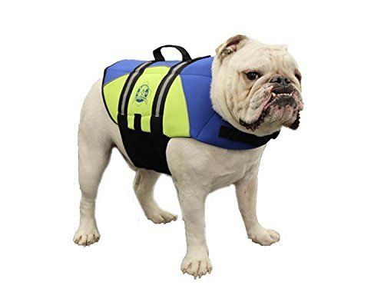
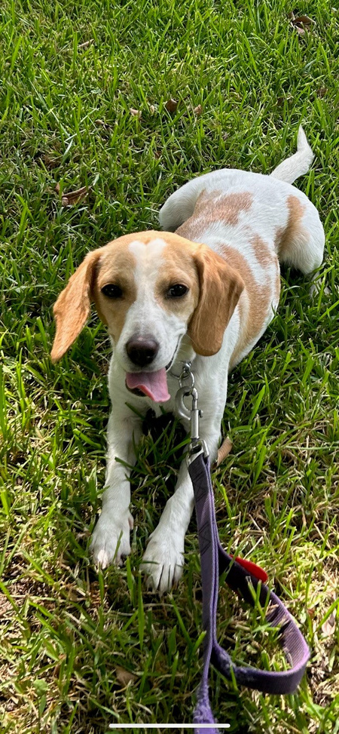
SafePaws
Our Solution
Continuous & Convenient Monitoring
Designed for Pet
Comfort
Less Expensive
than Competitors
Notes:
user experience - cost, ease of use
functionality - alerts, continuous, app
performance - data accurate, battery life

Slide 7
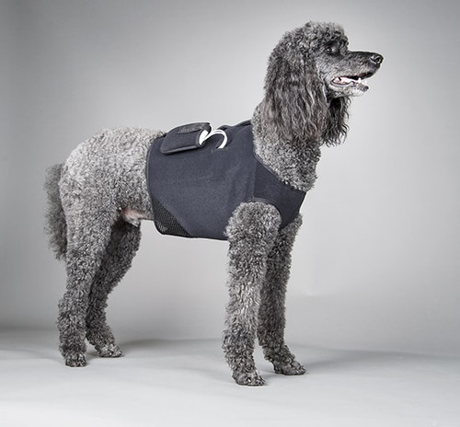
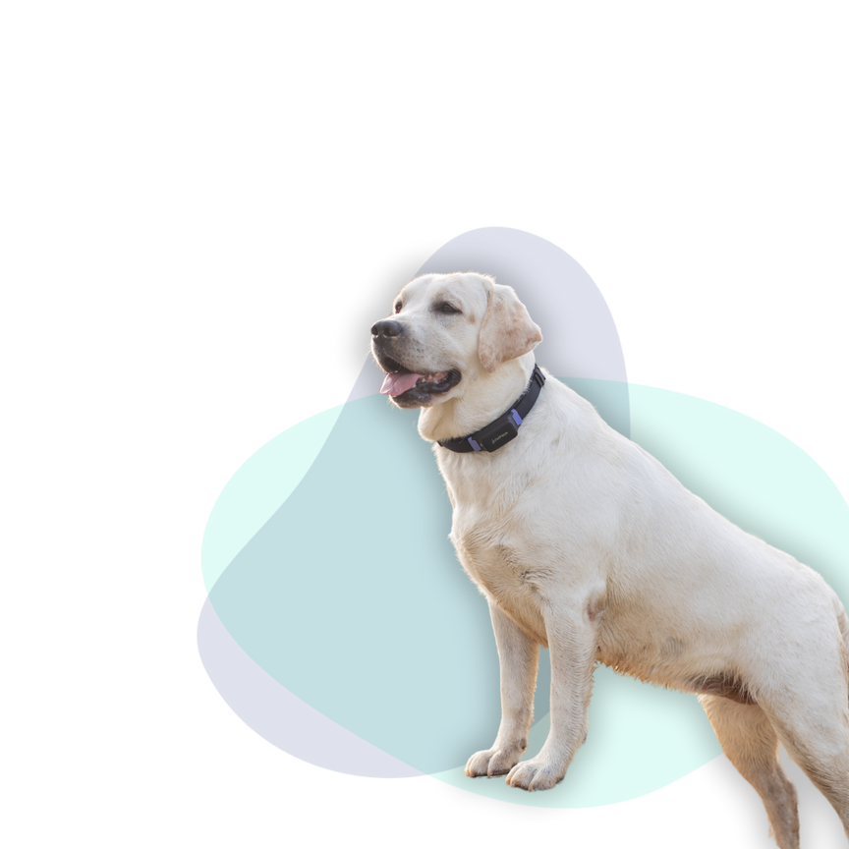
Competition
DogLeggs [1]
Specialized use
Limited connectivity
PetPace [2]
Expensive initial cost
Added subscription fees
SafePaws

Slide 8
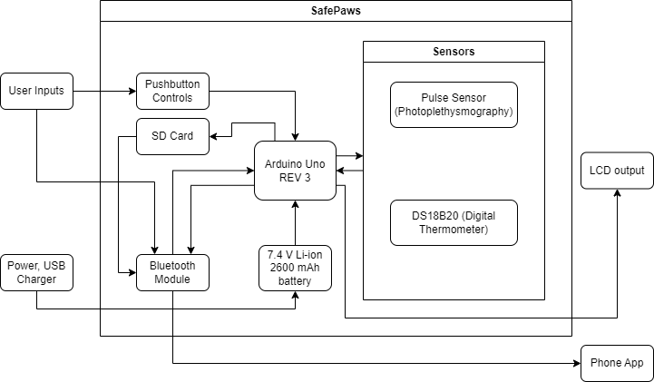
SafePaws
Design Overview

Slide 9




01
02
03
04
Subsystems
SafePaws

Slide 10
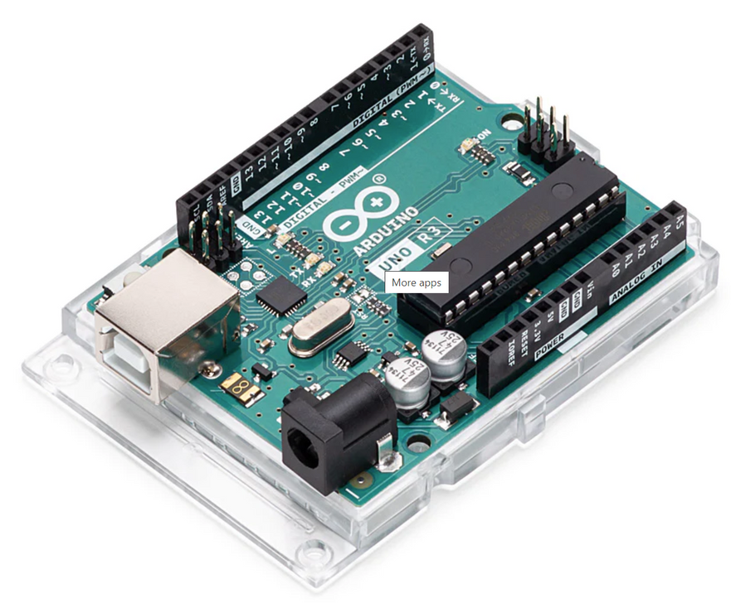
SafePaws
Controller
Arduino Uno REV3
Advantages: [3]
Low-power requirement
Support for a wide range of peripherals
SD card read/write
WiFI/Bluetooth
Digital/analog sensor support
Well-supported software library
SD-FATLIB (FAT16/FAT32 file systems)
Arduino BLE (Bluetooth), ConnectionHandler (WiFI)
Alternatives considered:
Basys Board (HDL-based programming)
Raspberry Pi (Lack of hardware/sensor support)
Arduino Uno REV3

Slide 11
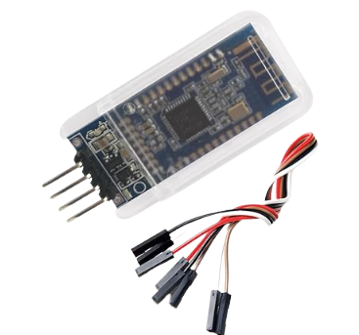
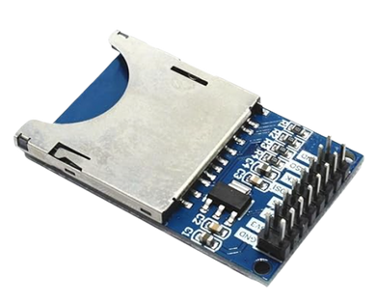
SafePaws
Communications
File Storage & Wireless Connectivity
SD Card
Bluetooth
Zittop SD Card Read/Write Module [4]
DSD TECH HM-10 M Bluetooth 4.0 LE [5]
Supports standard SD card sizes
480GB read/write speed support
Allows for SD card removability and hot-swapping
Multi-volt operation (3.3V or 5V)
Low power use
Bluetooth 4.0 support
4-wire connectivity
Bluetooth Low Energy (BLE)
1.0 Mbps data transfer rate
Notes:
not completed

Slide 12
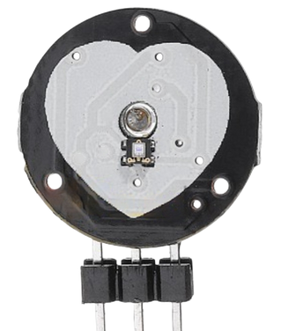
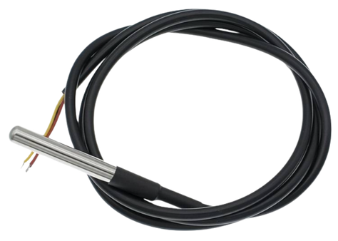
SafePaws
Sensors
Heartrate and Temperature Monitoring
Heartrate Sensor
Thermometer
Pulse Sensor
(Photoplethysmogram)
PPG utilizes a light-emitting diode to detect changes in blood volume [6]
LED wavelength output is 565 nm
Ease of use
DS18B20
(Digital Thermometer)
DS18B20 uses one-wire interface feature [7]
Wider temperature range versus the alternatives
More accurate readings
Notes:
ease of use?

Slide 13
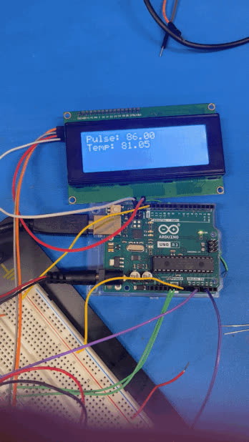
SafePaws
Sensors
Notes:
slide for sensor demonstration

Slide 14
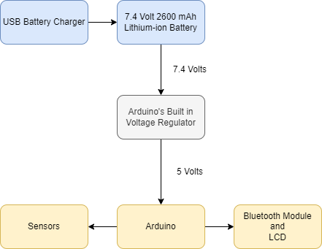
SafePaws
Power
Power System & Voltage Regulator
Lithium-Ion (Li-ion) Battery
7.4V 2600mAh li-ion battery capacity
Arduino steps down usage to 5 volts
37 hours of usable battery life (goal of 24 hours)
Removable battery
USB rechargeable

Slide 15
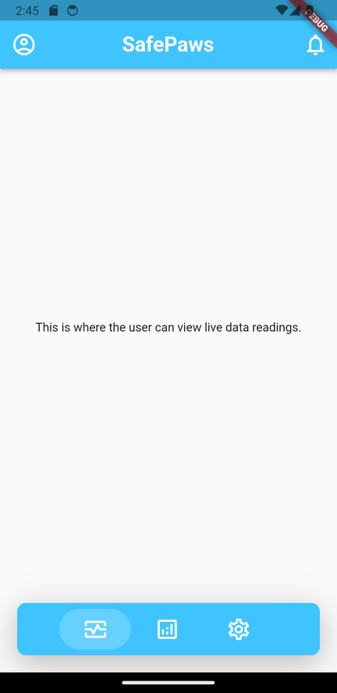
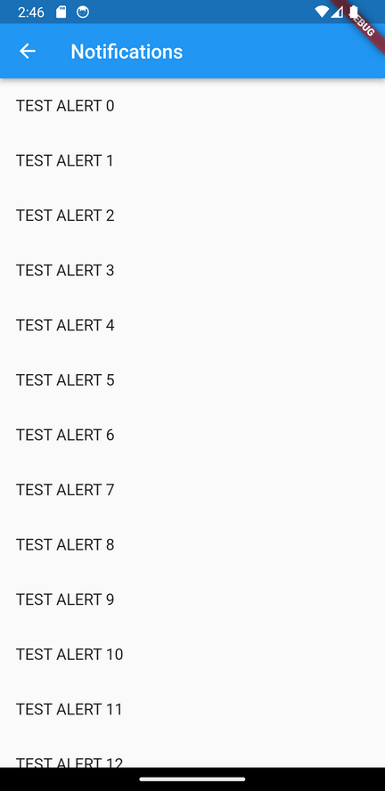





Mobile Application
Easy to Use
Modern Design
Cross-Platform Compatibility
Notifies & Alerts the User
SafePaws

Slide 16
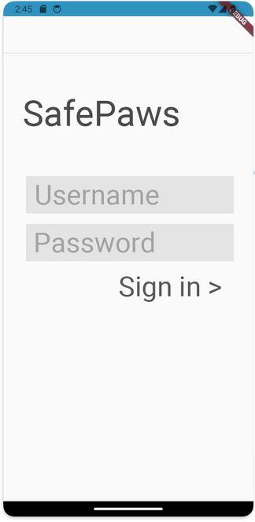
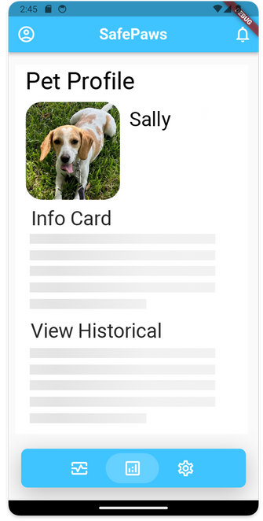
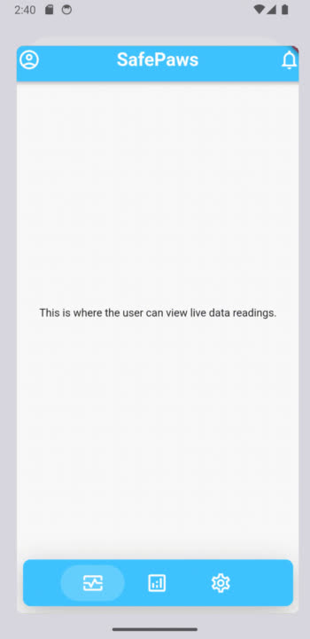
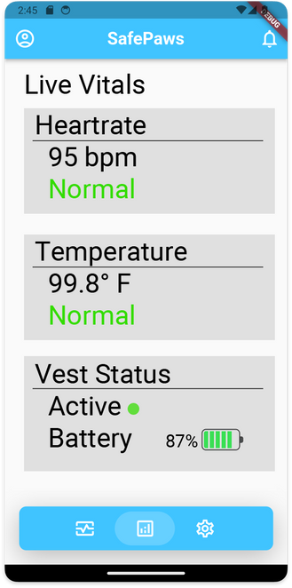
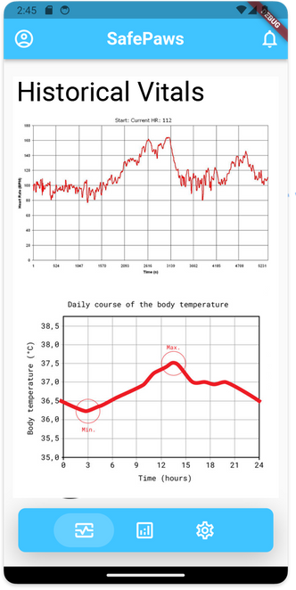
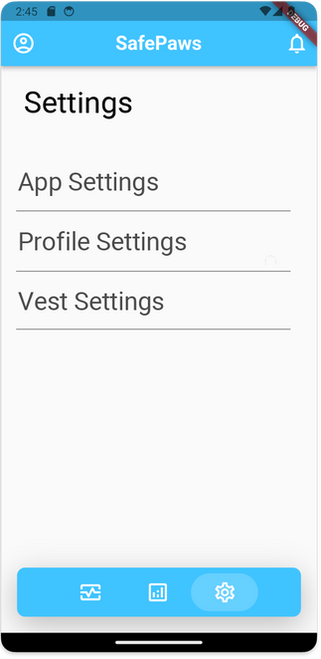
SafePaws
Notes:
slide for app demonstration

Slide 17

SafePaws
Upcoming
Implementation into vest
Subsystems are currently configured loosely; the next step is to integrate them into the vest in such a way to meet our constraints (water resistance, insulation, etc.).
Removal of LCD
The LCD is currently installed for testing purposes only. It will not be integrated into the final design, as the required data will be transmitted wirelessly to the mobile app.
App Development
The application software is still being developed with the intention to meet deadline constraints..

Slide 18

Reflections
Challenges
Teamwork
Design
Limitations
Time
Money
Lack of knowledge
Lessons Learned
Coding
Communication

Slide 19


Conclusion
Our journey began with the need for more accessible health monitoring for pets.
SafePaws is a convenient, continuous tool that allows the user to remote monitor their four-legged companion.

Slide 20
References
[1] “Dog Leg Wraps, Braces, & Carpal Support | Hygroma Treatment Solutions,” dogleggs.com. https://www.dogleggs.com/ (accessed Sep. 01, 2023).
{2] “How it works - PetPace,” PetPace.com, https://petpace.com/how-it-works/ (accessed Sep. 01, 2023).
[3] “Arduino Uno R3 Specification Sheet.” Arduino Documentation. https://docs.arduino.cc/hardware/uno-rev3 (accessed Oct. 20, 2023).
[4] “Zittop SD Card Reader/Writer for Arduino,” Amazon. https://www.amazon.com/Virtuabotix-Reader-Writer-Arduino-Microcontrollers/dp/B0089SYU9C (accessed Nov. 8, 2023).
[5] “DSD Tech HM-10 for Arduino,” Amazon. https://www.amazon.com/DSD-TECH-HM-10-Bluetooth-Compatible (accessed Nov. 8, 2023).
[6] “Waterproof 1-Wire DS18B20 Digital Temperature Sensor,” Adafruit.com.
https://www.adafruit.com/product/381?gclid=CjwKCAjws9ipBhB1EiwAccEi1I_Cpjkz6gxzXgaTveIUXc
OG1HRZNsbkSlXBfyg8ZbmgEaWvQ2WrZRoCuzIQAvD_BwE (accessed Nov 8, 2023).
Notes:
references not completed

